Slide 1
Data Analysis of Trade Data

Slide 2
01
Descriptive Analysis
02
Unsupervised Learning
03
04
Machine Learning
Bonus Questions

Slide 3
Descriptive analysis
PART ONE

Slide 4
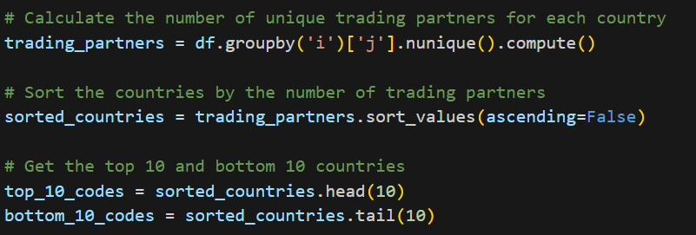
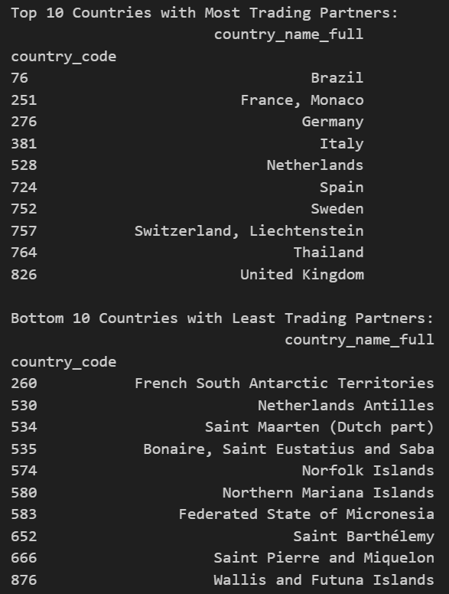
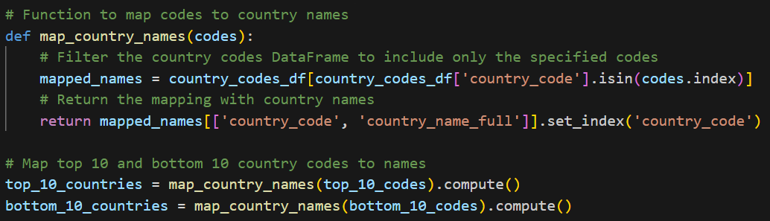
Descriptive analysis
Use dask to read files
Calculate the number of unique trading partners for each country
Map codes to country names

Slide 5
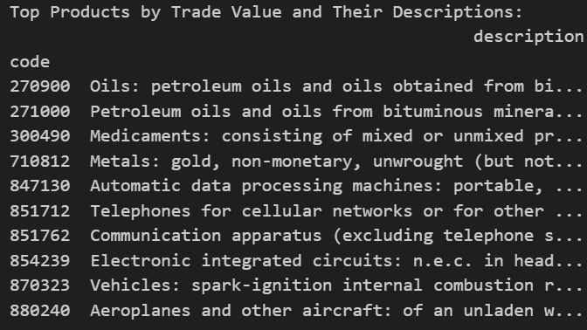
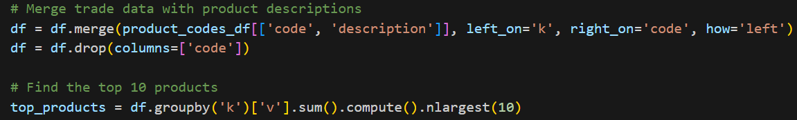
Descriptive analysis
Find the five highest value sectors in terms of value
Merge trade data with descriptions
Use group by
The top 5 sectors in the rankings are petroleum, pharmaceuticals, metals, communications, and automobiles

Slide 6
Descriptive analysis
Find the five highest value sectors in terms of value
Merge trade data with descriptions
Use group by
The top 5 sectors in the rankings are petroleum, pharmaceuticals, metals, communications, and automobiles

Slide 7
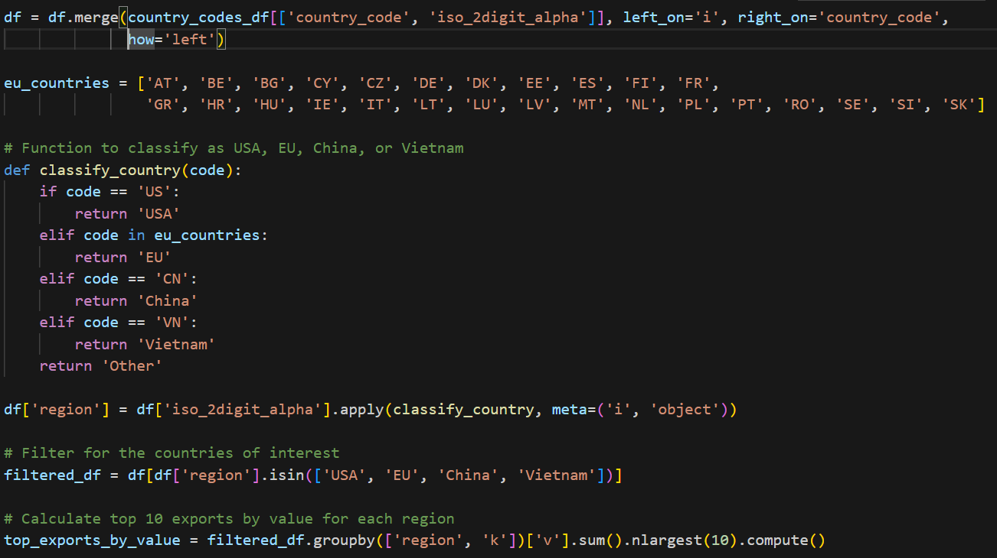
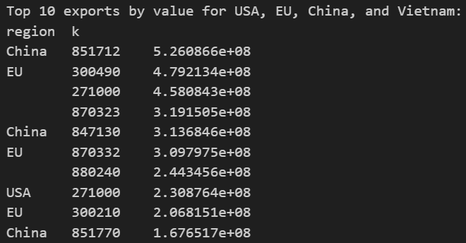
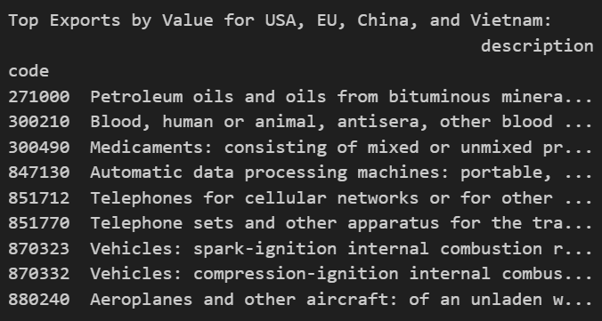
Descriptive analysis
Add new column to classify data as USA, EU, China, or Vietnam
Use group by to find 10 exports by value for USA, EU, China, and Vietnam

Slide 8
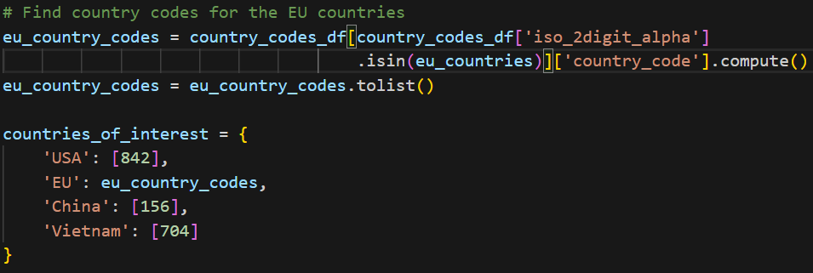
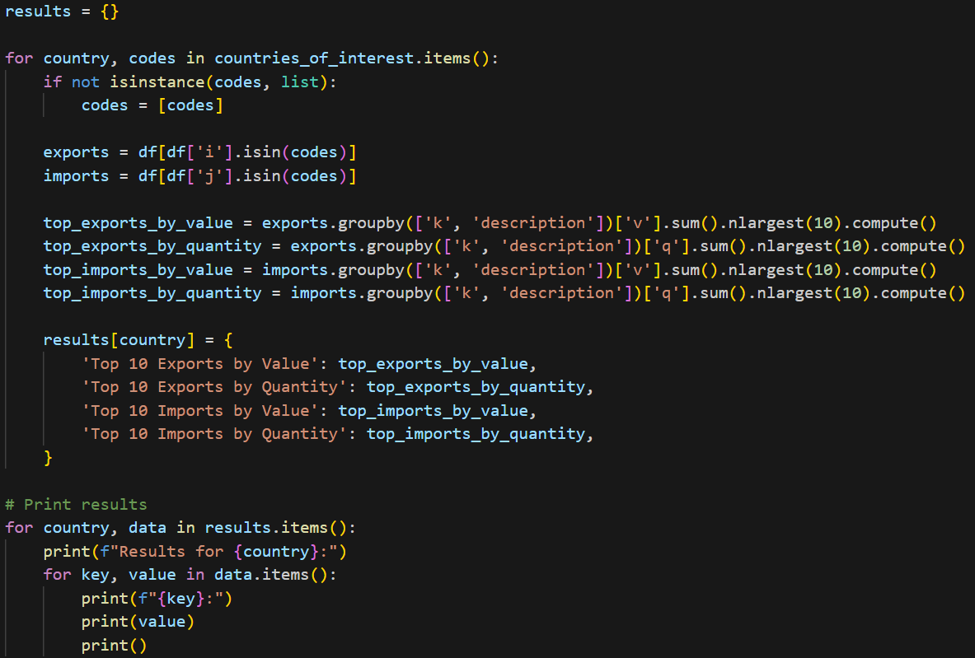
Descriptive analysis
Find top 10 goods with the highest trade volume for both exports and imports in terms of value and quantity

Slide 9
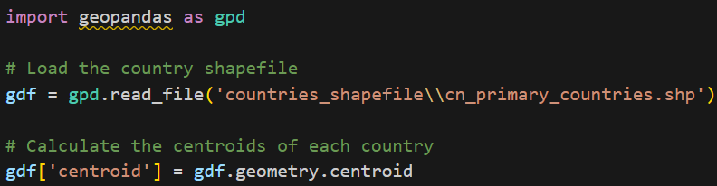
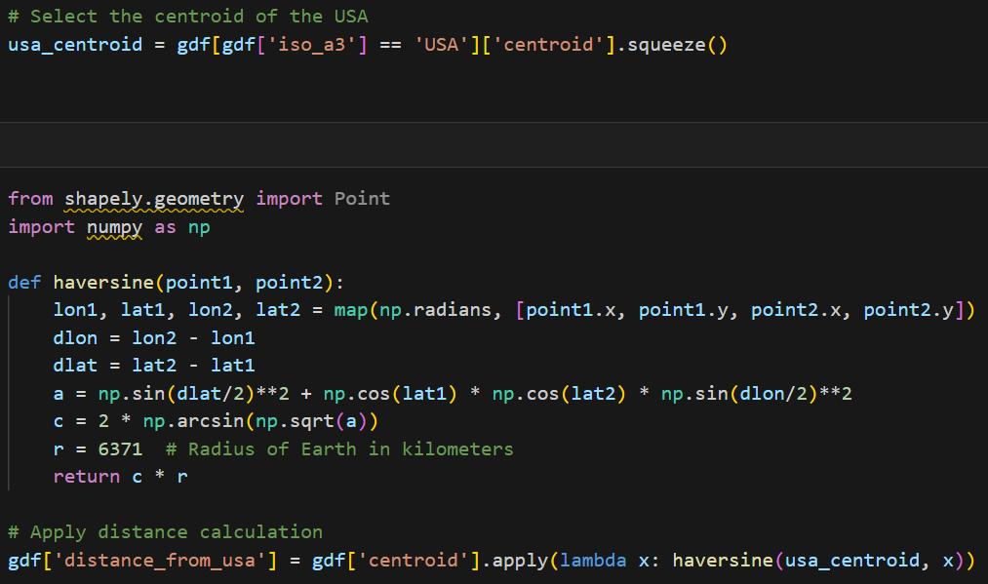
Descriptive analysis
Use geopandas to read file
Use harvesion function to calculate distance

Slide 10
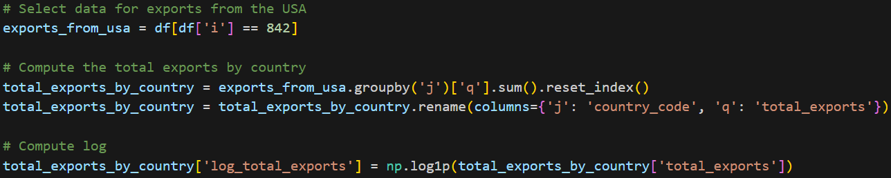
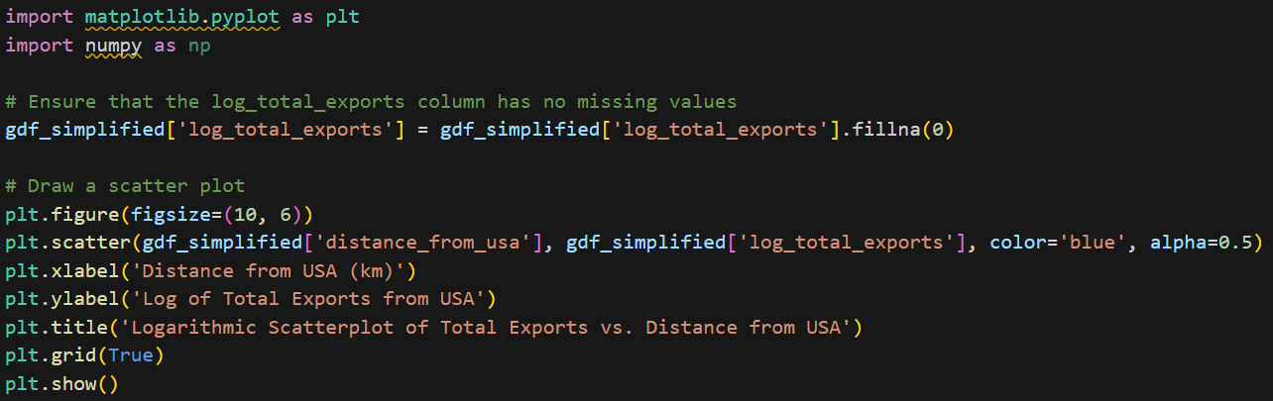
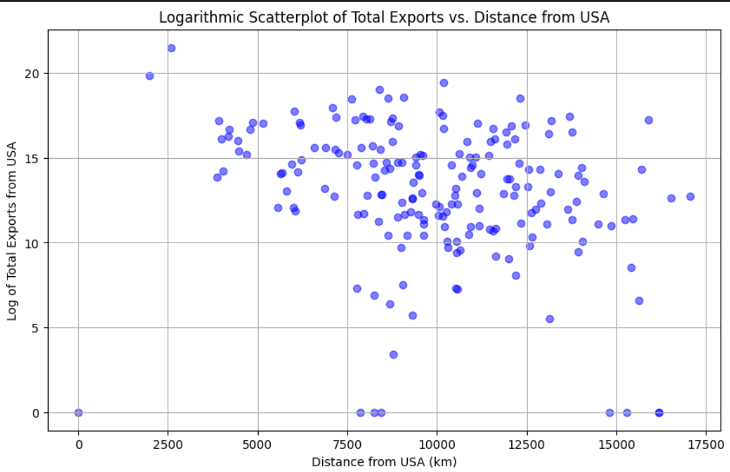
Descriptive analysis
Select data for exports from USA
Compute the total exports by country
A logarithmic transformation was used to reduce the variability and range of the data
Visualize the result
The distribution of points exhibits a trend, such as a diagonal line from top left to bottom right, which may indicate that an increase in distance to the United States is associated with a decrease in total export volume

Slide 11
Unsupervised Learning: Identifying Trade Patterns
PART TWO

Slide 12
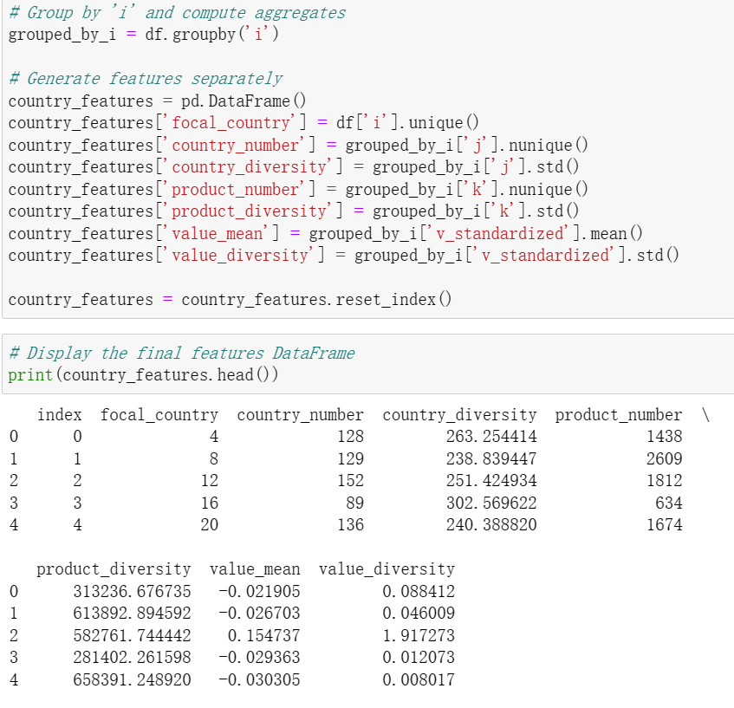
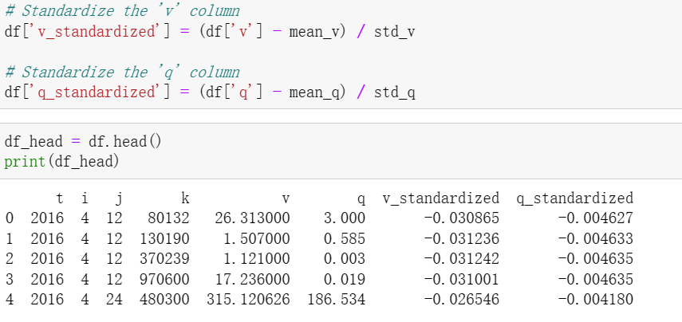
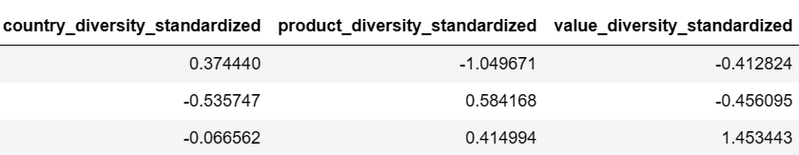
Procedures
Data preprocessing
Standardization
Aggregation to country level
Export country (i) as cluster index (focal_country)
K-mean clustering
PCA analysis to reduce dimensionality
Previously 6 variables

Slide 13
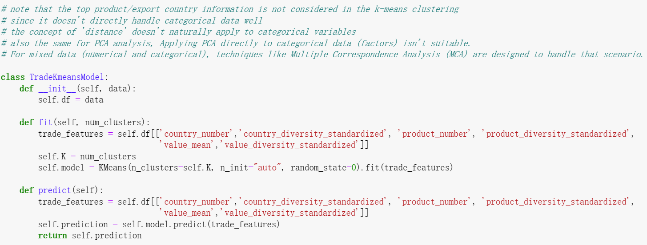
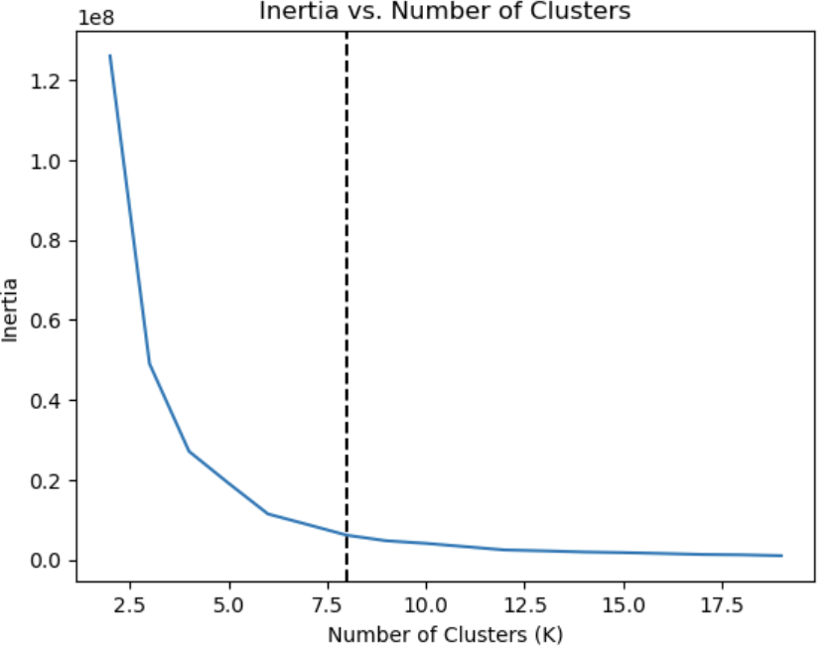
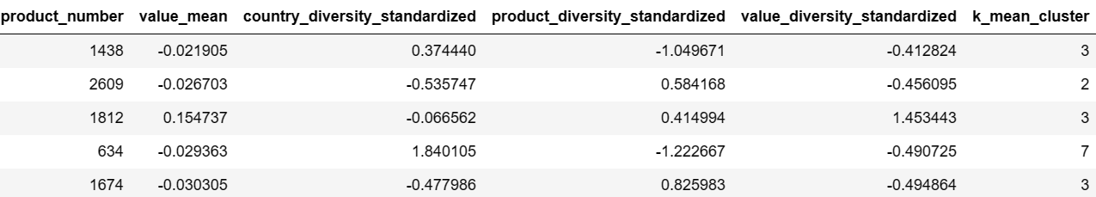
K-mean clustering

Slide 14
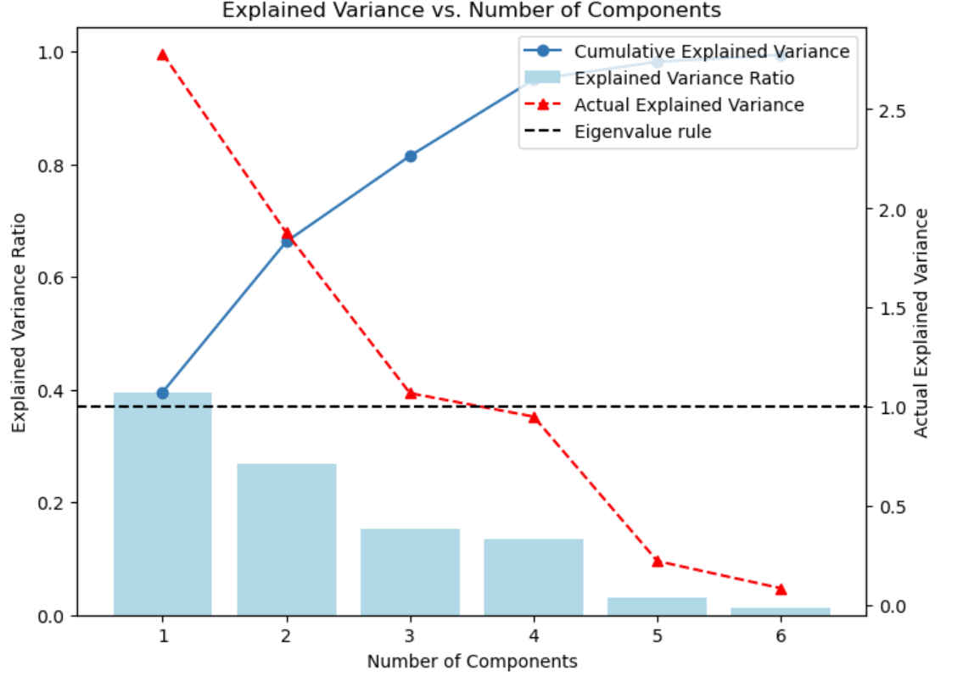
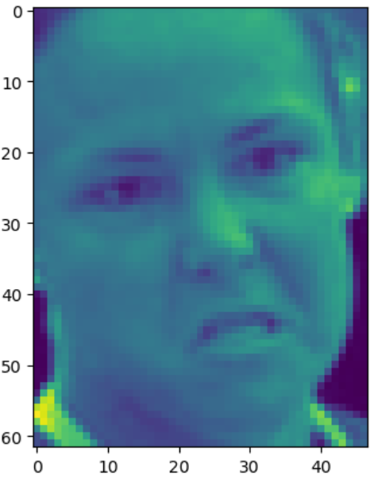

PCA analysis - exploration

Slide 15
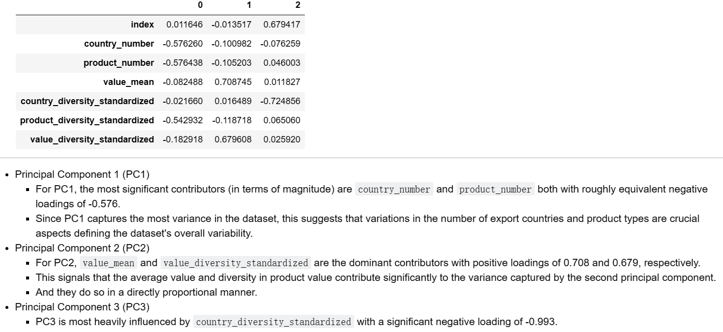
PCA analysis – decided components

Slide 16
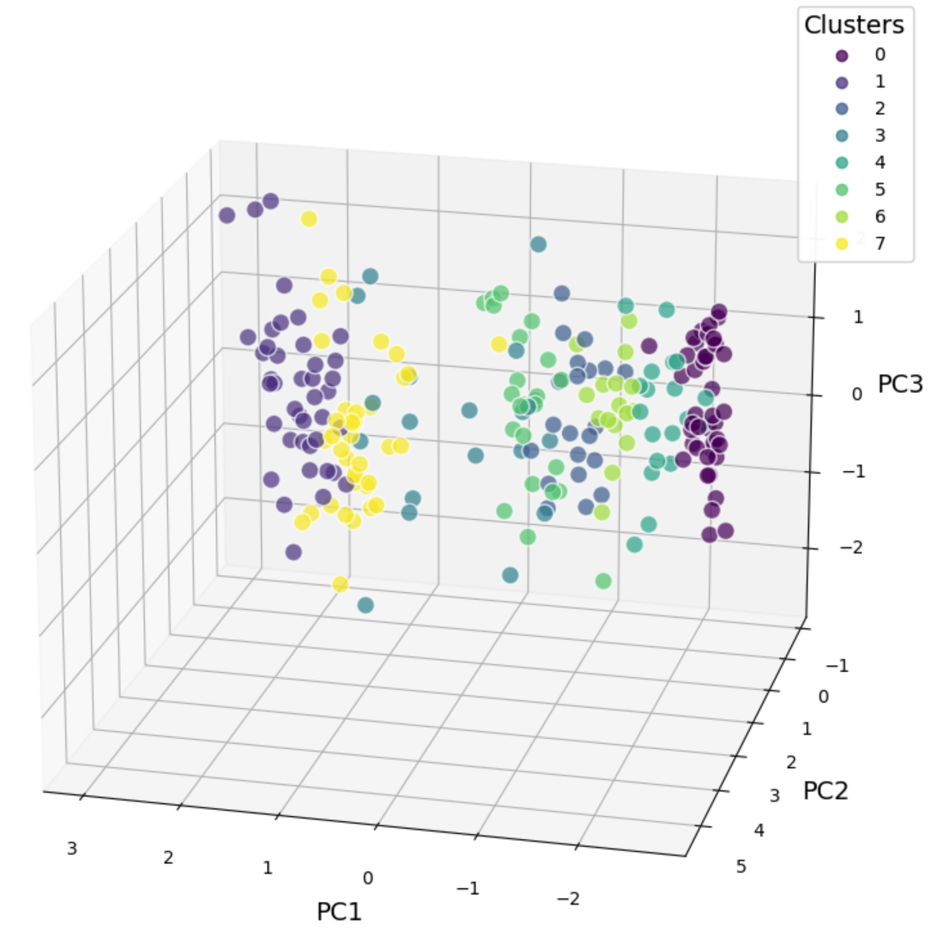
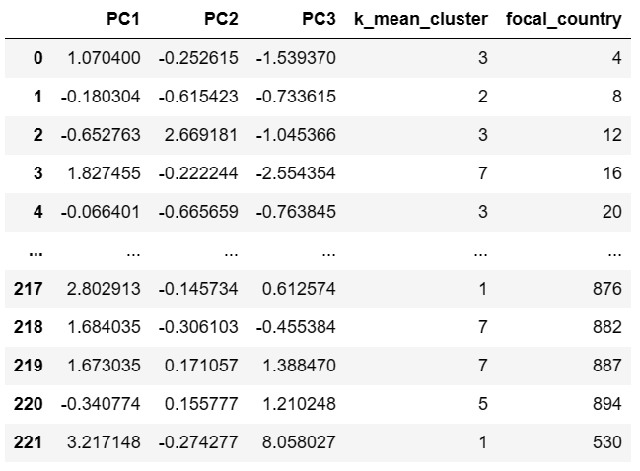
PCA analysis – visualization
Interactive plot (.html)

Slide 17
Machine Learning: Predicting Trade Flows
PART THREE

Slide 18
Procedures
Data preprocessing
Feature engineering
Numeric variables: Standardization
Categorical variables: one-hot encode
Generate ‘sector’classification
Split train/test sets
Random forest model (no aggregation)
Hyperparameter tuning
a subset of the whole dataset
grid search to detect the best model parameters
Model fit
Fit evaluation
Result interpretation

Slide 19
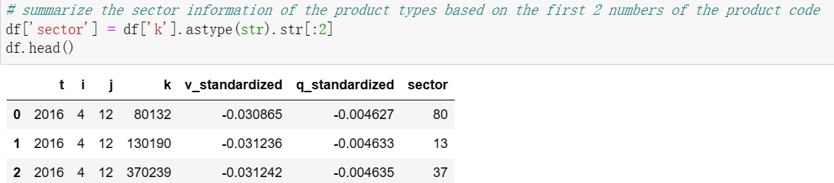
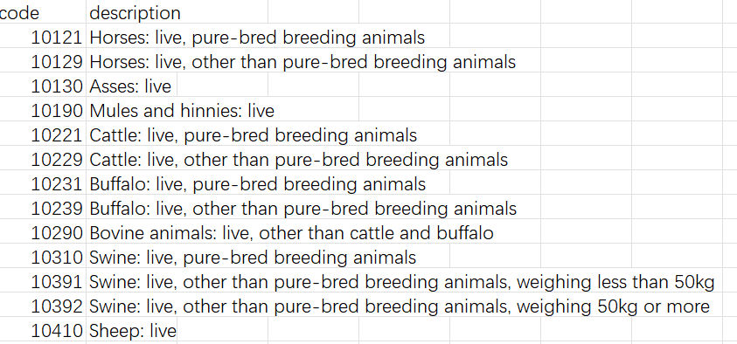
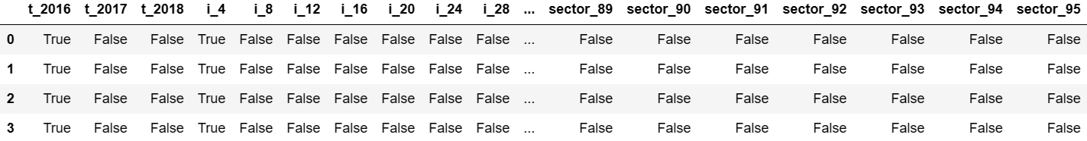
Feature engineering
standardization
‘sector’ creation
variables as.factors()
numeric changes are meaningless
result in 500+ columns

Slide 20
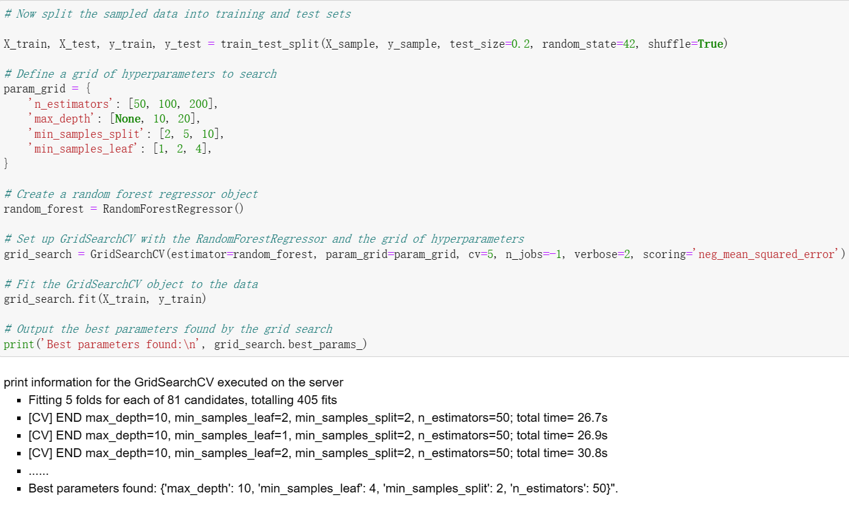
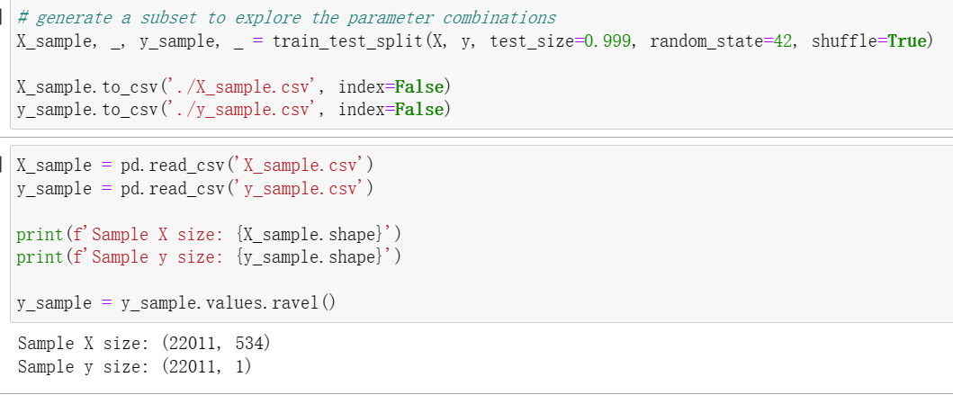
Hyperparameter tuning

Slide 21
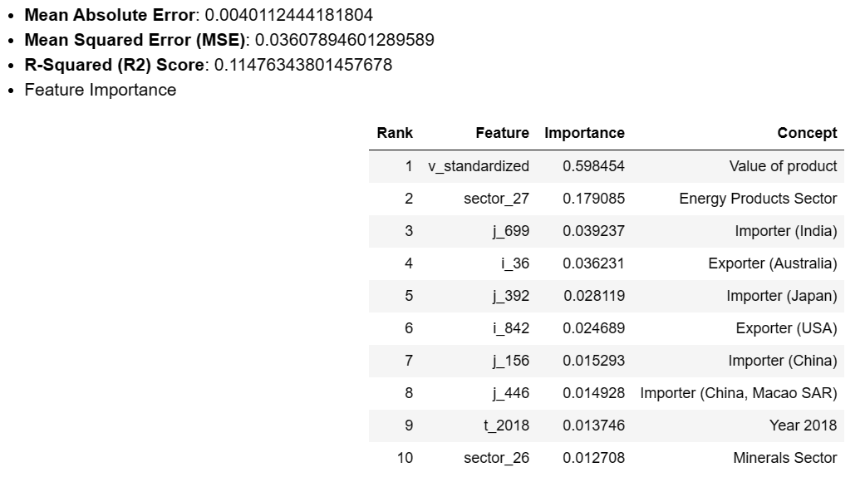
Model Results & Evaluation Metrics

Slide 22
Interpretation
Key Features for trade quantality analysis
Product value: Primary predictor, affirming economic value's influence on trade quantities
Energy & Minerals Sectors: Sector_27 & sector_26 underline the importance of natural resources
Geopolitical Factors: Significant roles of countries like India, Australia, Japan, the USA, and China illustrate geopolitical and economic influences
Temporal Insights: Inclusion of t_2018 signals impact of time-related changes (e.g., trade policies)
Limitations
Limited R^2 score indicates scope for enhancing model’s comprehensiveness
Sector and country specificity may limit generalizability to underrepresented categories
Dynamic trade complexities pose challenges to prediction accuracy
Potential overreliance on v_standardized could oversimplify complex trade dynamics

Slide 23
Bonus Questions
PART FOUR

Slide 24
Bonus Questions
Economically, the impact of distance on exporting commodities is related to transportation costs and the nature of the goods being traded.
Transportation Costs: The farther a commodity needs to travel to reach its market, the higher the transportation costs. The heavier a commodity is, the higher the cost.
Nature of Goods: Different commodities have different sensitivities to distance. Perishable items like fruits and vegetables suffer more from long distances due to spoilage risks. On the other hand, high-value goods like electronics might be less affected by distance because transportation costs form a smaller part of their overall value.
Data Needed:
Export Data: Detailed information on what each country exports and to where.
Distance Data: Distances between exporting countries and major trading partners.
Transportation Costs Data: Information on shipping costs, including rates and modes of transport.
Analysis:
Compare Distances: Calculate average distances for each commodity sector to different export markets.
Cost Analysis: Analyze how transportation costs vary across sectors and how they relate to distance. (Regression analysis)
Case Studies: Look at specific examples within sectors to understand how distance impacts trade.

